Slide 1
DevOps

Slide 2
Agenda
DevOps Overview
DevOps different phases
DevOps Services and tools

Slide 3
DevOps Overview:
DevOps is the combination of cultural philosophies, practices, and tools that increases an organization’s ability to deliver applications and services at high velocity: evolving and improving products at a faster pace than organizations using traditional software development and infrastructure management processes. This speed enables organizations to better serve their customers and compete more effectively in the market.
Why DevOps needed:
Poor integration among development, infrastructure, security and support teams.
Deploying software has predominately been the role of the IT operations group.
Developers like to build software and change things quickly, whereas IT operations focus on stability and reliability. This mismatch of goals can lead to conflict, and ultimately the business may suffer.

Slide 4
Nowadays, these old divisions are breaking down, with the IT and developer roles merging and following a series of systematic principles:
• Infrastructure as code
• Continuous integration
• Continuous testing
• Continuous deployment
• Automation
• Continuous Monitoring

Slide 5
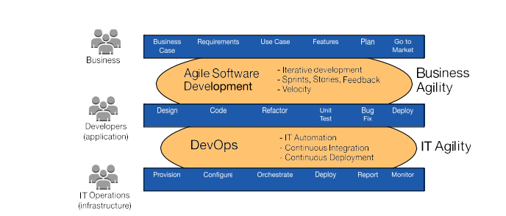
How DevOps fits in Agile:
First it was Waterfall, next it was Agile, and now it's DevOps. This is how modern developers approach building great products. With the rise of DevOps has come the new methods of Continuous Integration, Continuous Delivery, (CI/CD) and Continuous Deployment. Conventional software development and delivery methods are rapidly becoming outdated.
The coevolution of agile software development and DevOps

Slide 6
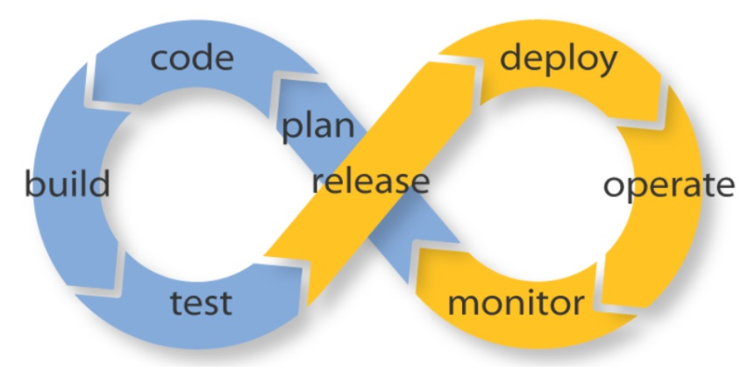
How we can achieve DevOps:
Merging developer and IT operation roles and goals.
Automation
Continue Integration and Continue Deployment
The adoption of CI/CD has changed how developers and testers ship software.
Continuous deployment is a higher degree of automation, in which a build/deployment occurs automatically whenever a major change is made to the code.

Slide 7
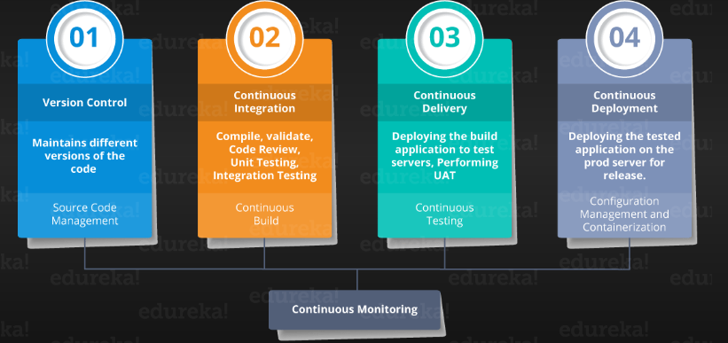
DevOps Phases: Major components of DevOps:

Slide 8
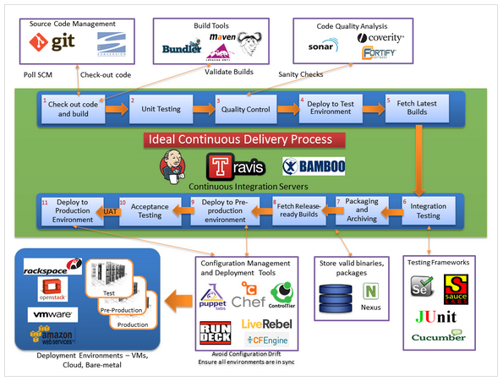
CI CD Lets discuss CI CD and tooling involve in this:

Slide 9
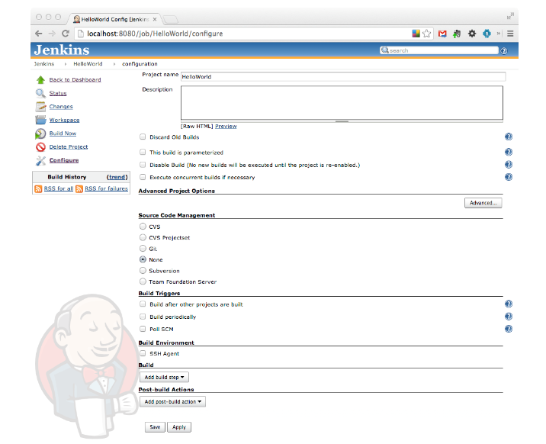

Slide 10
Queries???

